Slide 1
Linear Algebra HW3 Cosine Transform
吳思霖

Slide 2
Outline
What is signal
Fourier Transform
Cosine Transform
HW3
Input&output
Code&util function
Rules

Slide 3
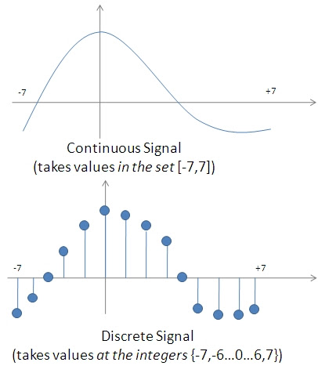
What is signal
傳遞有關一些現象的行為或屬性的資訊的函數
Example
f(t) : 音訊
f(x, y)：圖片
Type
Continous
Discrete
In this homework, we use
discrete signal

Slide 4

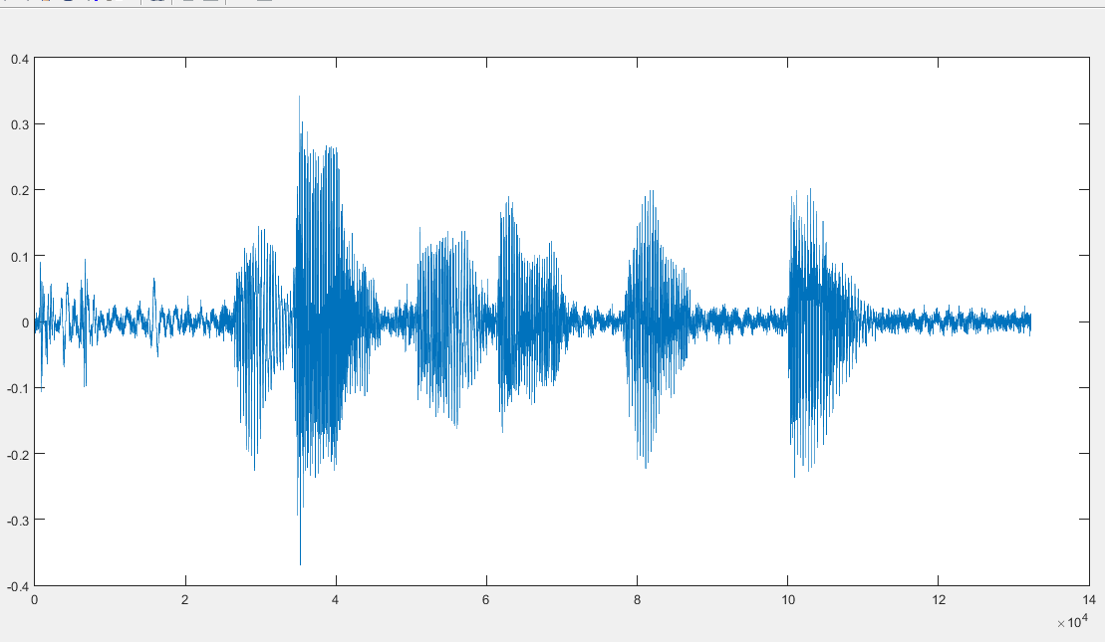
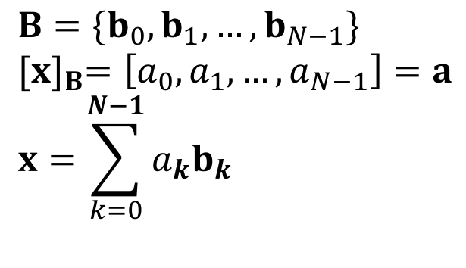
Basis
How to use basis in signal analysis
Given a speech signal
Can we find basis to describe this signal ?
One period T
exists b that is easy to analysis? (basis is also a signal)

Slide 5
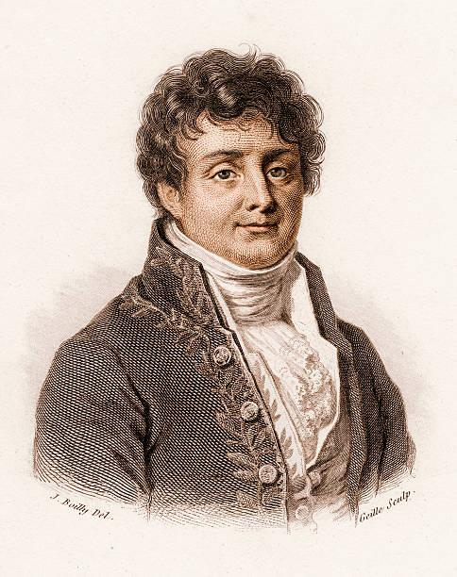
Joseph Fourier
Any periodic signal can be represented as a sum of sinusoids.

Slide 6
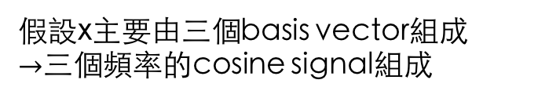
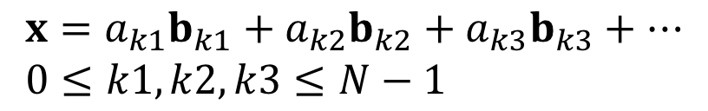

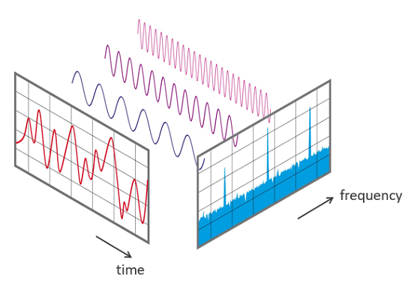



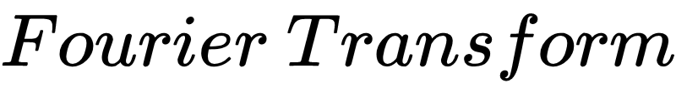






Fourier Transform
時間上的強度
頻率上的強度
Notes:
Stop

Slide 7
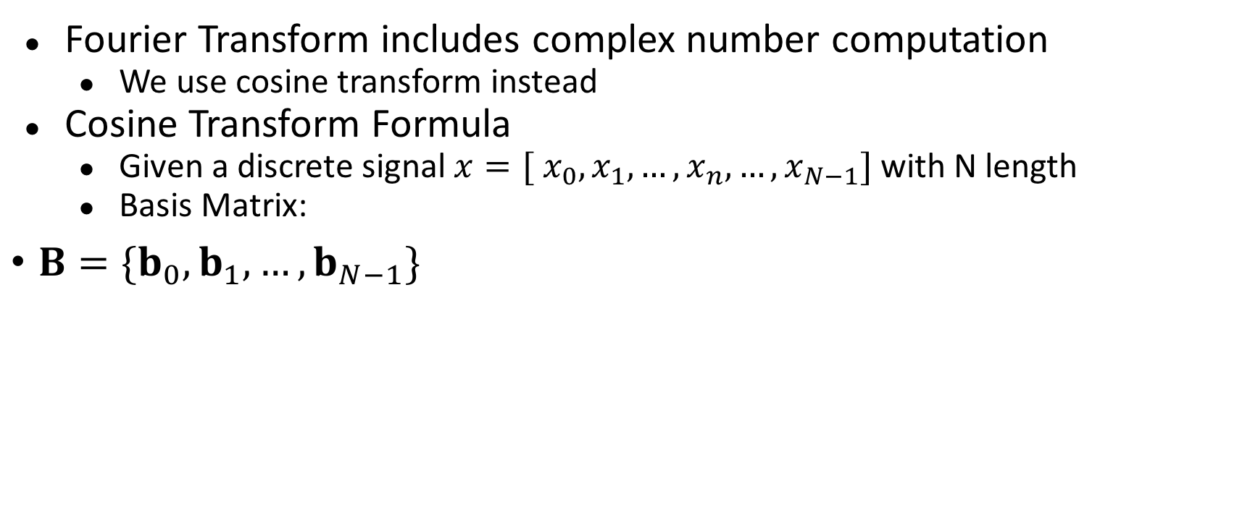
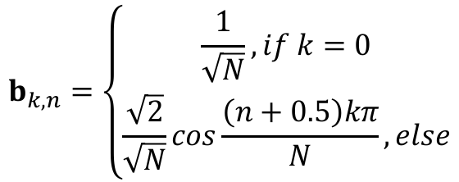
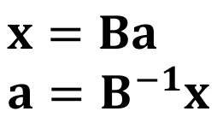
Cosine Transform
How to get a
n: 時間上的index
k: 頻率上的index

Slide 8







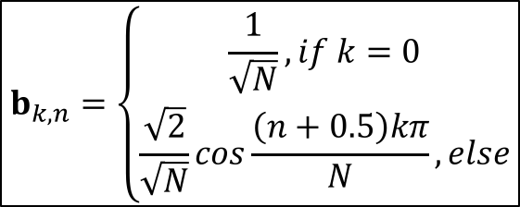






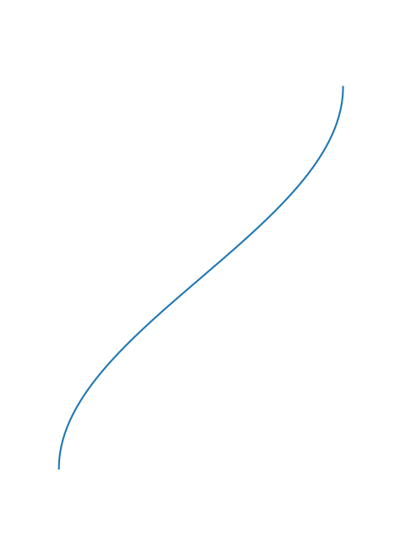
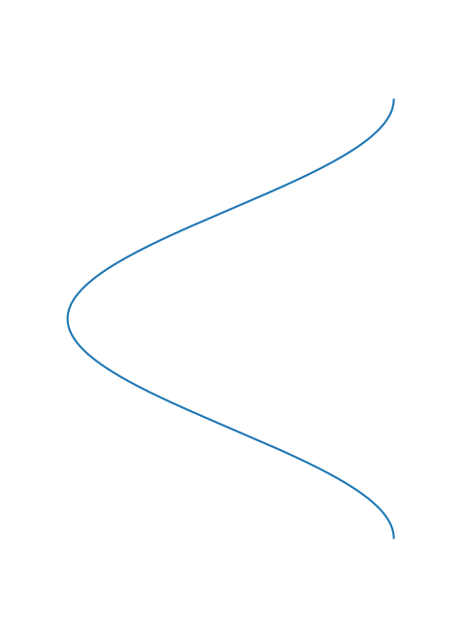
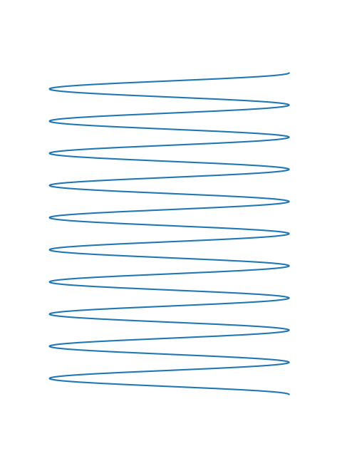
・・・
・・・
・・・

Slide 9
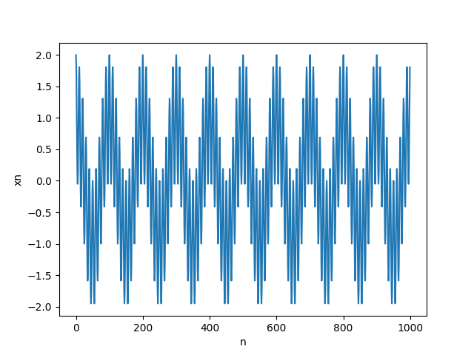
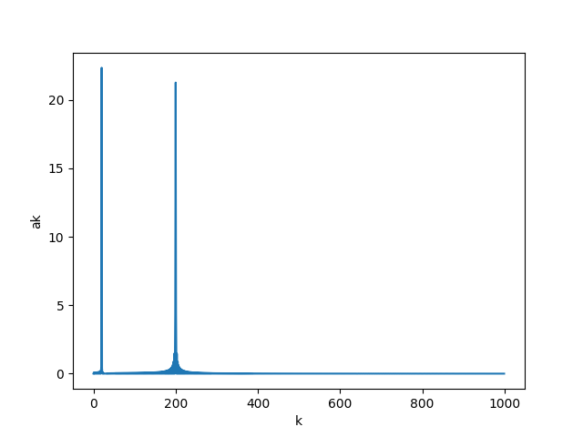

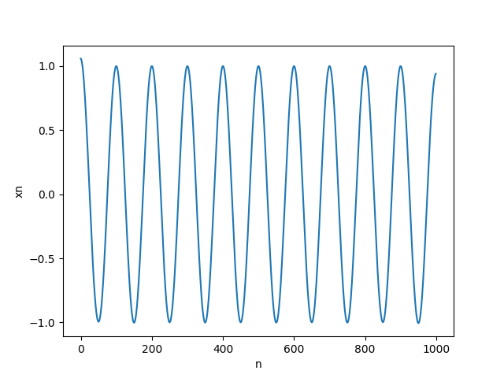
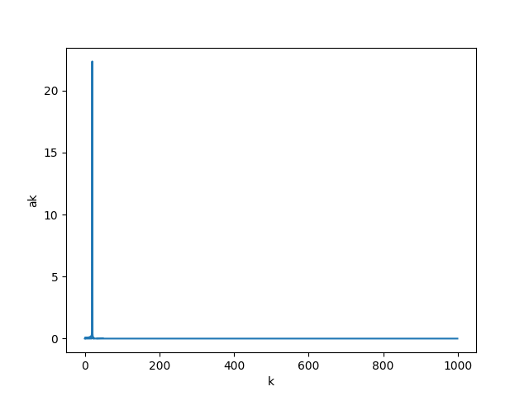
If we want to get the low frequency signal of a mixed signal…
Cosine transform
x
mask
[ 1 1 0 0 0 0 0 0 0 0 0 0 0 0 0 0 0 …]
Inverse cosine transform
Notes:
mask

Slide 10
Application
Filter
Human voice
Man: 85-180Hz
Woman: 165-255Hz
Remove high frequency noise from speech signal

Slide 11
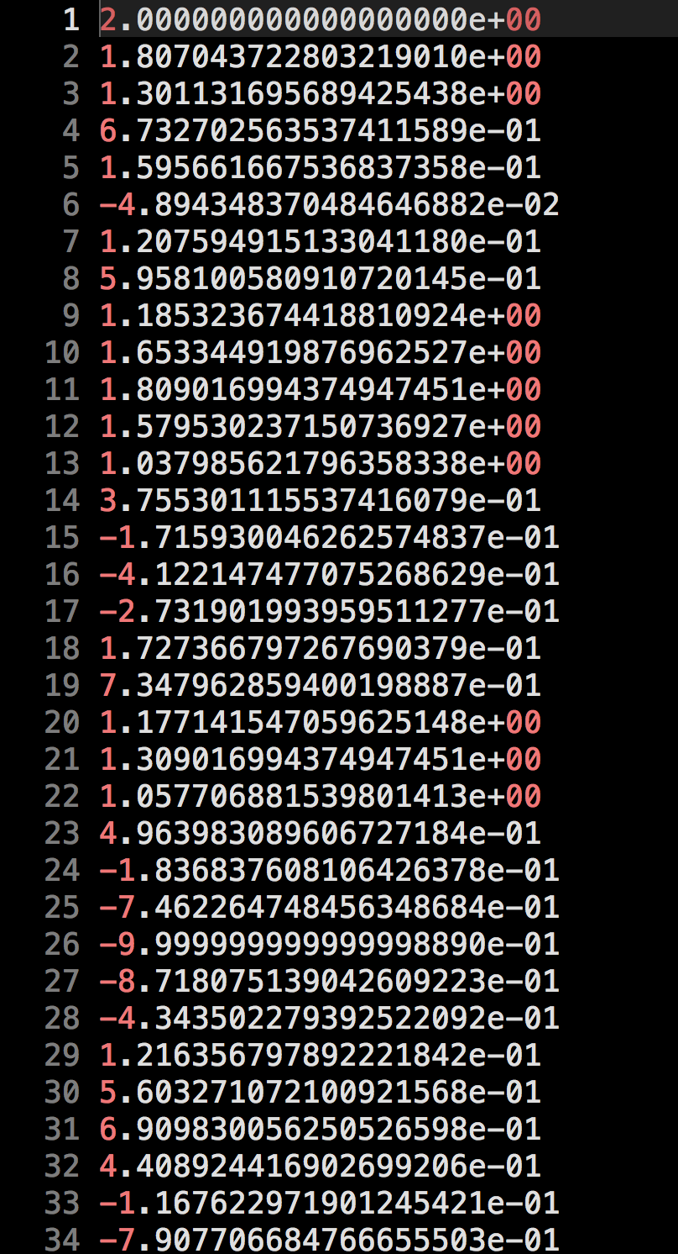
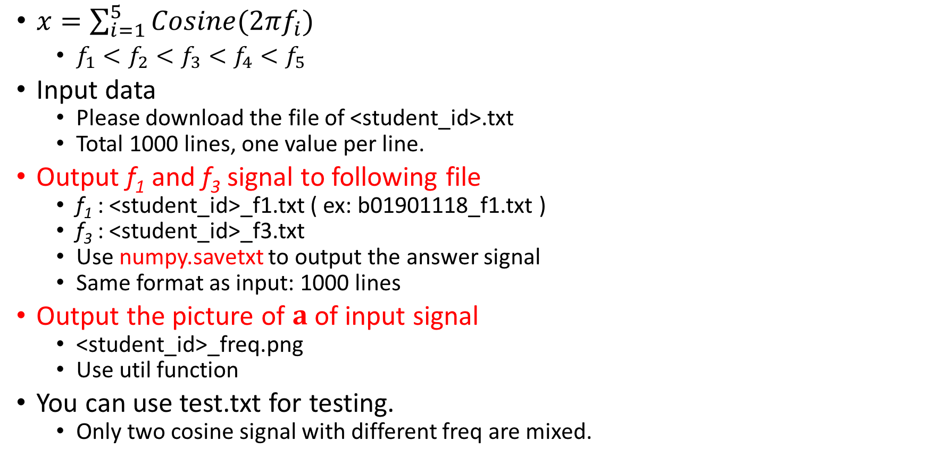
Input & Output

Slide 12
Code & Data link
Link
Code
hw3.py
Data
<student_id>.txt
test.txt

Slide 13
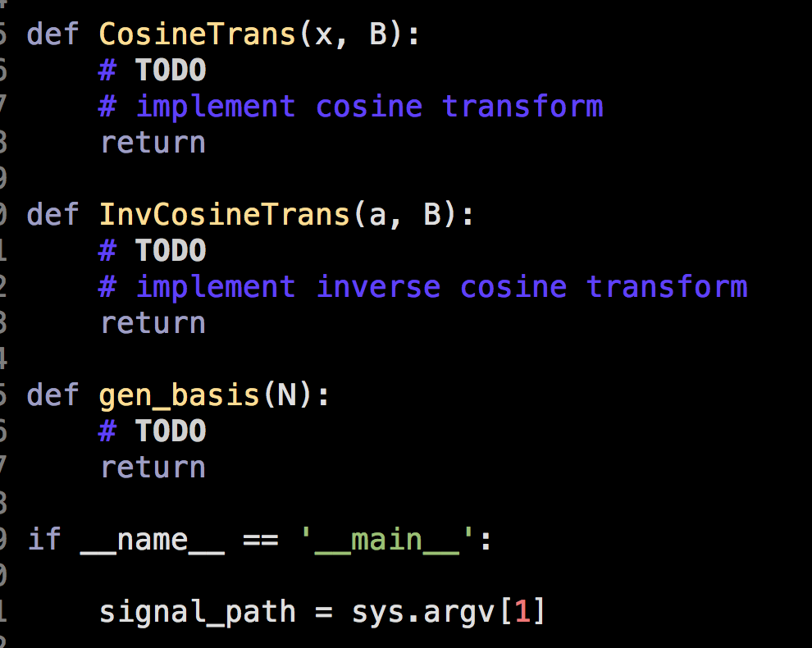
HW3 Code

Slide 14
Run the code
python hw3.py <input_signal_txt>
Your code should generate 2 txt files and 1 png file.
<student_id>_f1.txt
<student_id>_f3.txt
<student_id>_freq.png
These three files should be in the same folder with hw3.py

Slide 15
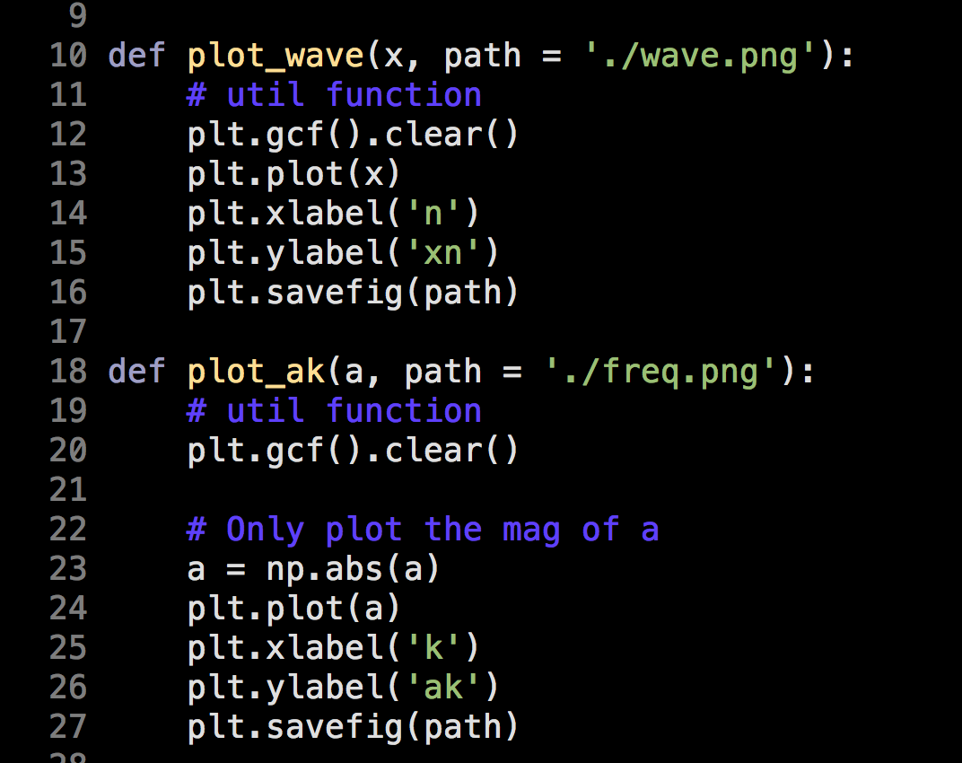

Some util function

Slide 16
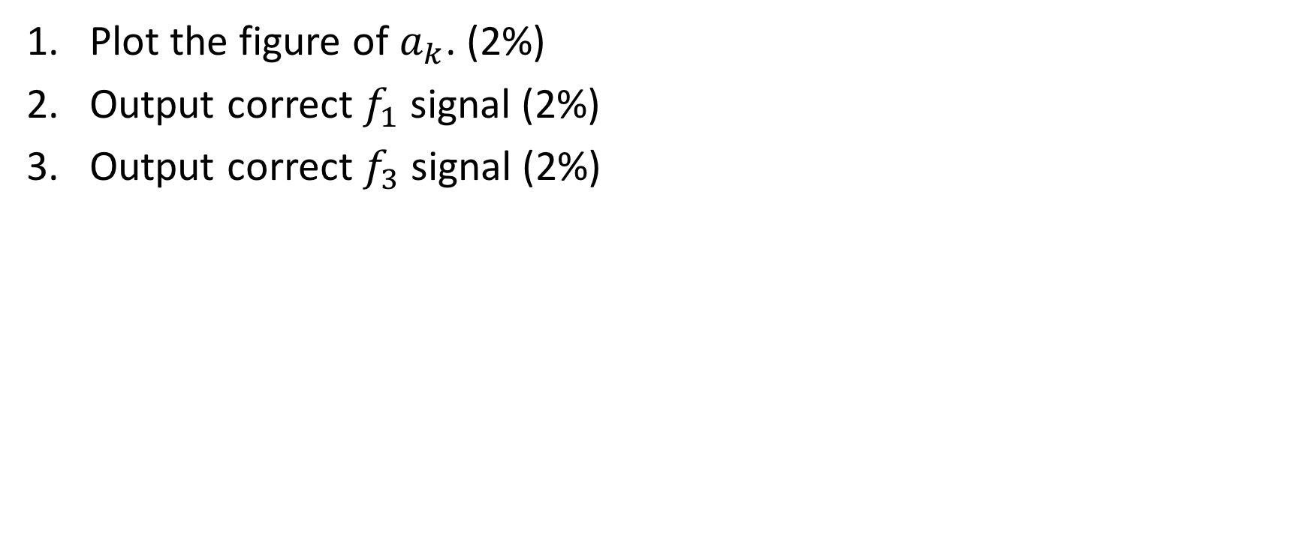
Scoring

Slide 17
Submit
Code you download
|-- hw3.py
Code you submit should be put in a folder and compressed in a zip file
r07922072_hw3.zip
|-- ./r07922072_hw3
|-- hw3.py
|-- r07922072_f1.txt
|-- r07922072_f3.txt
|-- r07922072_freq.png

Slide 18
Standard Rules
不要抄作業，不要交別人的答案，作弊一律0分計算
上傳 zip 檔案到 CEIBA
注意繳交的資料夾學號開頭英文用小寫
DEADLINE: 2018/11/15(四) 23:59 (GMT+8:00)
遲交每過一天：分數×0.8 (per day)
格式、檔案、各種奇怪的錯誤讓我無法改作業：分數×0.8

Slide 19
Code Rules
You can‘t
Use cosine transform formula in appendix to generate seperated signal
只准使用inverse matrix的方法產生指定的三個檔案
可以實作，但僅限於檢查inverse matrix的方法是否正確
import scipy
Or other cosine transform package

Slide 20
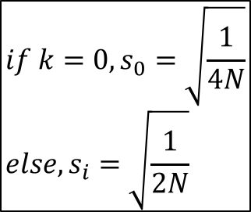
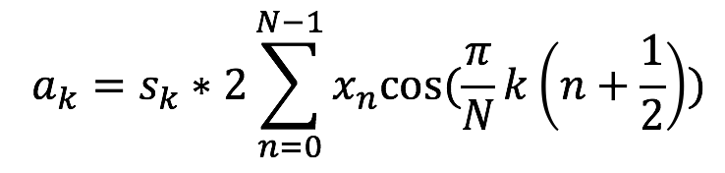
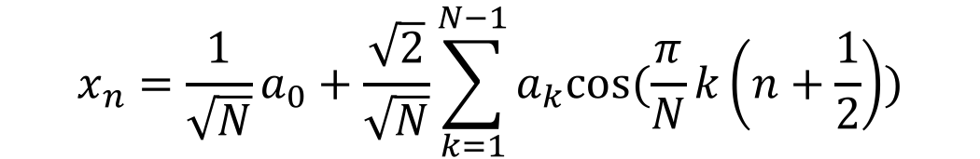
Appendix - Cosine Transform Formula
Cosine transform
Inverse Cosine transform

Slide 21
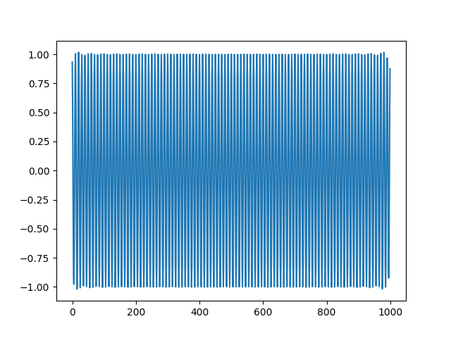
Update - test.txt的高頻波型

Slide 22
Update - 改作業的流程
假設同學的學號是r07922072，且對應的波檔是r07922072.txt
我會run
>>python hw3.py r07922072.txt
在程式中，r07922072.txt這個字串是由sys.argv[1]傳進程式裡的
同學的檔案要可以生出r07922072_f1.txt、r07922072_f3.txt、r07922072_freq.png，且在同一個資料夾下

Slide 23
Update - inverse matrix
同學可以直接用numpy.linalg.inv這個函式拿inverse matrix
Ref

Slide 24
Update - text.txt
新增s1.txt/s2.txt，分別為合成text.txt的兩個波
檔案在同個連結裡
Link

